Slide 1
Do Your Part,
Be Water Smart!

Slide 2
Risk of Drowning
Drowning is a leading cause of death for children in the United States.
Ten people each day die from unintentional drowning.
Drowning is responsible for more deaths among children ages one to four than any other cause except birth defects.
Among those 1-14, drowning is the second-leading cause of unintentional injury-related death behind motor vehicle crashes.
For every child who dies from drowning, another five receive emergency care for nonfatal submersion injuries.
Drowning is a silent killer—most young children who died by drowning in pools were last seen in the home, had been out of sight less than five minutes, and were in the care of one or both parents at the time.
Source: Centers for Disease Control (CDC), 2012, 2016
Notes:
Drowning is a major global public health issue and it may comes as a surprise to many that drowning is a leading cause of death for children in the United States.
Everyday, an average of 10 people die from accidental drowning. Of those, 2 are children under the age of 14.
For kids between 1 and 4, drowning is responsible for more deaths than any other cause except birth defects.
For kids from 1 – 14 years old, drowning is the 2nd leading cause of unintentional injury-related death, just after motor vehicle crashes.
And for every child who dies from drowning, another 5 receive emergency care for nonfatal submersion injuries.
Drowning is silent. Most young children who died in pools:
Were last seen in the home.
Had been out of sight less than five minutes
And were in the care of one or both parents at the time.

Slide 3
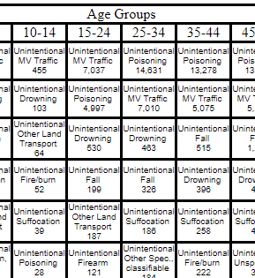
Source: WISQARSTM
Produced By: National Center for Injury Prevention and Control, Centers for Disease Control and Prevention
Data Source: National Center for Health Statistics (NCHS), National Vital Statistics System
Notes:
Drowning is a leading cause of unintentional injury death across all age groups in the United States. Overall, it’s the 6th leading cause for people of all ages.

Slide 4
More Facts
Research shows 64% of African-American, 45% of Hispanic/Latino, and 40% of Caucasian children have little to no swimming ability.¹
If parents have no/low swimming ability, there’s a high likelihood their children won’t have good swimming skills:¹
78 percent for African-American children
62 percent among Hispanic/Latino children
67 percent for Caucasian children
African-American children ages 5 to 19 drown in swimming pools at rates 5.5 times higher than those of white children in the same age range.²
79% of children in households with incomes less than $50,000 have little-to-no swimming ability.¹
Participation in formal swim lessons can reduce the likelihood of childhood drowning death by 88%.³
1 - National research study commissioned by the USA Swimming Foundation and conducted by the University of Memphis and of Nevada, Las Vegas (2017). USA Swimming Foundation
2 - CDC 2014.
3 - http://pediatrics.aappublications.org/content/126/1/e253.full.pdf
Notes:
Diving in a little bit deeper into the national picture. Statistics show that there is a disparity in swimming ability among African American and Hispanic/Latino children and that the fatal drowning rate is higher amongst African American children.
Research shows 64% of African-American, 45% of Hispanic/Latino, and 40% of Caucasian children have little to no swimming ability.
If parents cannot swim there is a high likelihood their children are unable to swim
African-American children ages 5 to 19 drown in swimming pools at rates 5 and 1/2 times higher when compared to Caucasian children.
79% of children in households with incomes less than $50,000 have little-to-no swimming ability.

Slide 5
Can you swim?
Can your child swim?
Notes:
Before we go any further, let me ask you with a show of hands. Can you swim? Next, can you child swim?

Slide 6
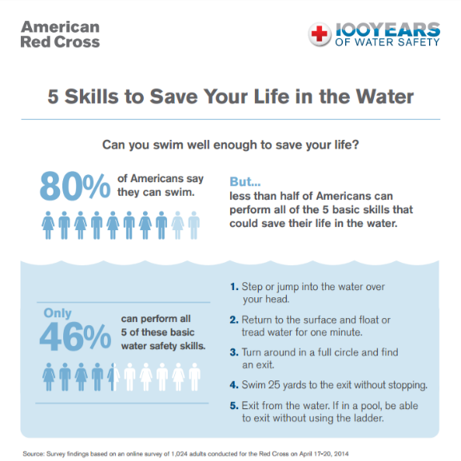
Notes:
The Red Cross conducted a survey, asking people if they knew how to swim. Seems like a simple question. 80% of the respondents said they could, but when we listed the skills that we believe are the basics of “knowing how to swim”, that number dropped to only 46%.
For African Americans, that number dropped to 33%, yet 69% said they could swim.
Knowing how to swim is a life skill that everyone should have. The Red Cross has defined water competency – the minimum skills everyone should have – as these skills, in a sequence:
Stepping into water over your head and returning to the surface.
Treading water or floating for a minute to gather your bearings.
Rotate in full circle to find an exit.
Swim at least 25 yards to get to a safe exit.
And get out of the water. If in a pool, exit without using the ladder.
Now think about your answers regarding your ability or your child’s ability to swim. Based on this definition – do your answers change?
It’s very important to understand that different conditions can affect your ability. Being able to perform these skills in a pool won’t necessarily translate to a river, due to things like currents, water temperature.
Children and adults should participate in swim lessons at least until they can achieve water competency in whatever environment they are swimming in.

Slide 7
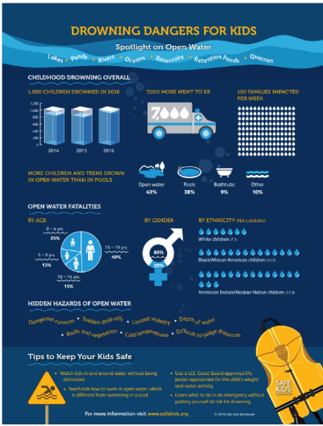
Dangers of Open Water
As children get older, they are more at risk of fatally drowning in open water.
More than half of open water drownings occur in children under 15.
For children older than 15, 9% drown in pools compared to 73% drown in open water
Boys are at greatest risk: 8 in 10 open water fatal drowning victims are males.
African American children are twice as likely to fatally drown in open water than their white counterparts. American Indian children are at even higher risk.
Download the infographic – and learn more - at SafeKids.org
Notes:
A recent study was published by Safe Kids Worldwide, with support from Nationwide’s Make Safe Happen initiative. This study revealed that, while the number of fatal drownings among children and teens declined over the past several decades, the downward trend stopped between 2015 and 2016, when there was a 14 percent increase in fatal drownings. The 1,002 drownings in 2016 (which is the latest data available) was the highest number in five years.
The statistics are alarming. According to Safe Kids Worldwide:
As children get older, they are more at risk of fatally drowning in open water.
Between ages 1 and 4, 57% of drownings occur in pools and 22% in open water.
More than half of open water drownings occur in children under 15.
By the time children are older than 15, the risk of open water compared to pools is far greater: only 9% of children 15-19 years of age drown in pools, compared to 73% who drown in open water.
Boys are at a much greater risk of a fatal open water drowning than girls, with 84 percent of open water drownings in children ages 0-19 occurring in males. This difference is greater than fatal pool drownings, where 68 percent are male.
Black/African American children are twice as likely as White children to fatally drown in open water. The risk for Native American children is even greater, at 2.4 times the rate of their White counterparts. For males, the highest drowning rates were found among Black/African American males ages 15-19
I encourage you to download the infographic and to learn more at safekids.org.

Slide 8
What Everyone Must Know
Notes:
I have shared many statistics with you. So what can we do to change those?
First, everyone needs to know how to prevent drowning from happening in the first place – even when you are not swimming, but around bodies of water. Prevention starts with knowing – and applying - the layers of protection that make up the Circle of Drowning Prevention. These are:
Providing close and constant supervision to children you are supervising in or near the water.
Fencing pools and spas with adequate barriers, including 4-sided fencing.
Learning to swim and learning water safety survival skills.
Ensuring that children, inexperienced swimmers and boaters wear U.S. Coast Guard-approved life jackets.
And
Swimming in areas that are protected by lifeguards.

Slide 9
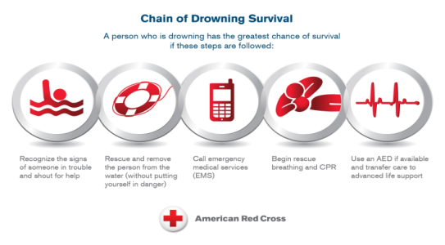
What Everyone Must Know
Notes:
It also takes knowing how to respond in an emergency. A person who is drowning has the greatest chance of survival if these steps are followed:
Recognizing the signs of someone who is in trouble in water, and calling for help.
Rescuing and removing that person from the water – without putting yourself in danger.
Calling emergency medical services to get help on the way – and at the same time –
Starting full CPR – that is a combination of chest compressions and rescue breaths
And using an AED if its available then transferring care to advanced life support.
These links are known as the Chain of Drowning Survival.

Slide 10
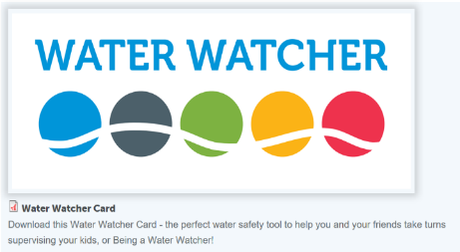
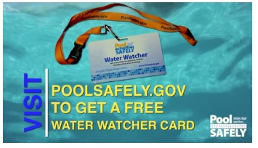
Actively supervise kids around all bodies of water.
Designate a “water watcher” whenever around water.
https://www.safekids.org/sites/default/files/documents/skw_water_watcher_card.pdf
https://www.poolsafely.gov/educational-materials-catalog/
Notes:
Designate a water watcher when you are in, on, or around water. That person should be free from distraction. If there are multiple adults and children, everyone should know who the water watcher is. An identifier, such as one of these lanyards with a water watcher card or a bright colored hat, should be worn by the water watcher. It’s a good idea to rotate people in the role of the water watcher – such as every 15 minutes or so. Be sure to pass on the identifier to whomever is in the role at the time.
Even with a water watcher, young children or inexperienced swimmers need to be within arm’s reach of an adult at all times.
An Appropriate Water Watcher
Is at least 16 years of age (adults preferred).
Has the skills, knowledge, and ability to recognize and rescue someone in distress or can immediately alert someone nearby who has that capability.
Knows CPR or can immediately alert someone nearby with that skill.
Has a working phone to be able to dial 9-1-1.
Has a floating and/or reaching object that can be used in a rescue.
Is alert and not under the influence of drugs or alcohol.

Slide 11
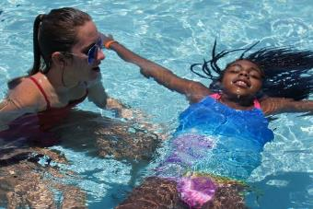
Learn to swim—and be sure all your family members can, too.
Swimming is a life skill for people of all ages - and it's not too early or never too late to learn.
Find Red Cross swim lessons by:
Visiting redcross.org/takeaclass and searching our Learn-to-Swim Provider directory.
Calling your local aquatic facility and asking for Red Cross programs.
Notes:
Everyone – children and adults alike – should learn how to swim through formal swim lessons. Swim lessons teach the water safety, survival and swimming knowledge and skills needed to handle yourself in a water emergency.

Slide 12
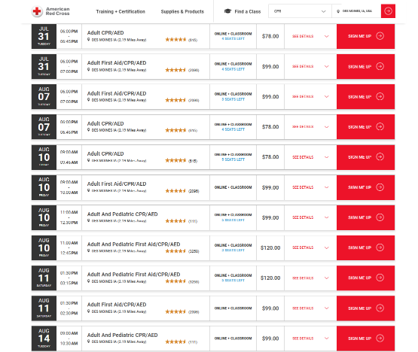
Learn CPR.
To find a class near you, visit:
Redcross.org/takeaclass
Notes:
All parents and caregivers – including babysitters, older siblings, grandparents – need to know water safety and how to tell if someone is in trouble in the water.
They also need to know how to help in an emergency, including how to perform full CPR – again, that combination of chest compressions and breaths.
These are just a sampling of the Red Cross CPR courses that are available in the Des Moines area. To find classes, visit RedCross.org/takeaclass.

Slide 13
Wear Life Jackets.
Wear a U.S. Coast Guard-approved life jacket when boating or participating in other recreational activities on the water.
Keep weak- and non-swimmers in them when they are around water.
Be sure to wear one that is:
U.S. Coast Guard approved
Appropriate for their weight and size
Intended for the activity and conditions
For younger children, choose a life jacket with both a collar for head support and a strap between the legs.
Notes:
Wear a U.S. Coast Guard-approved life jacket when boating or participating in other recreational activities on the water. Weak and non-swimmers in should wear life jackets – also sometimes referred to as personal floatation devices (PFDs) - when they are around water.
Children and adults should wear U.S. Coast Guard-approved life jackets appropriate for their weight and the water activity.
For younger children, choose one with both a collar for head support and a strap between the legs.

Slide 14
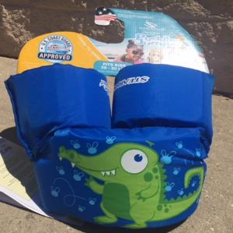
Beware of Toys and Swimming Aids
Swimming aids and water toys, such as water wings, inflatable water rings and foam noodles do not prevent drowning.
Notes:
Swimming aids and water toys, such as water wings, inflatable water rings and foam noodles do not prevent drowning.
While these two items look quite alike – there is a very big difference.

Slide 15
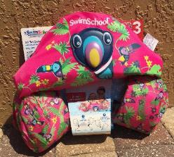
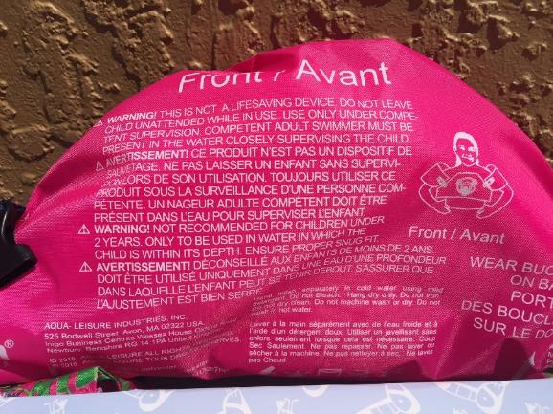
Read the Label Carefully
This one is a swimming aid – NOT a U.S. Coast Guard-approved life jacket.
“WARNING: THIS IS NOT A LIFESAVING DEVICE.”
Notes:
Be sure to carefully read the labels to ensure the one you select are actually U.S. Guard approved.

Slide 16
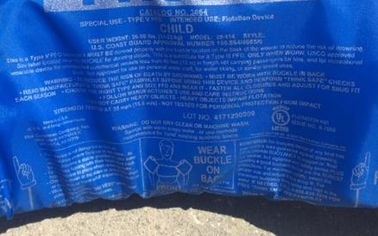
Read the Label Carefully
This one is a U.S. Coast Guard-approved life jacket.
“U.S. COAST GUARD APPROVED NUMBER 159...”
Notes:
Be sure to carefully read the labels to ensure the one you select are actually U.S. Guard approved.

Slide 17
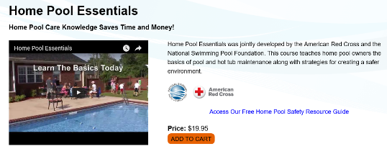
Take Steps to Help Keep Your Home Pool and Spa Safe
www.homepoolessentials.org
https://www.poolsafely.gov/educational-materials-catalog/page/3/
Notes:
If you have a home pool or spa, you must take steps to help keep it safe. The Home Pool Essentials course is an online course available through the American Red Cross and the National Swimming Pool Foundation. A publication is also available from the Consumer Product Safety Commission.

Slide 18
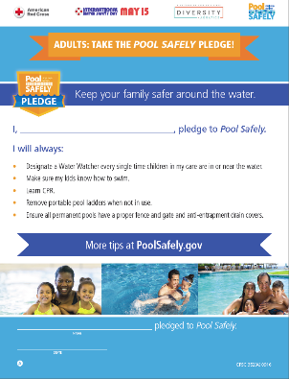
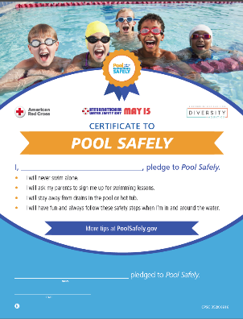
Take the Pool Safely Pledge
Take the Pledge online at poolsafely.gov/pledge
Notes:
The Pool Safely Pledge is a great way to cause children and adults to stop and think about water safety – and pledge to take steps to prevent drowning. I encourage each of you to take the pledge and to have your families do so as well. It’s quick and easy. Go to poolsafely.gov/pledge

Slide 19
Additional Open Water Safety Tips
Teach kids that swimming in open water is different than in a pool.
Use designated swimming areas and recreational areas that are protected by lifeguards, whenever possible.

Slide 20
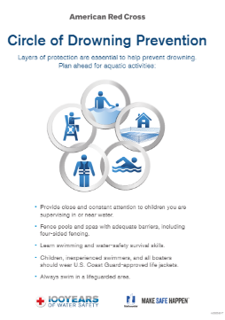
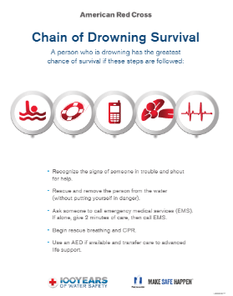
Teach Water Safety to Adults
Teach adults to help them make better decisions for all in, on and around the water. Topics range from general water safety and sun safety to specific environments, such as home pools and rip currents.
Access materials at redcross.org/teachwater safety
Notes:
If you want to get involved to help prevent drowning, you can be a water safety ambassador. You can help raise awareness of the risks of drowning and equip youth and adults with the knowledge of how to prevent drownings.
For adults, presentations make people safer though general water safety and specific topics, including home pool safety and rip current safety.

Slide 21
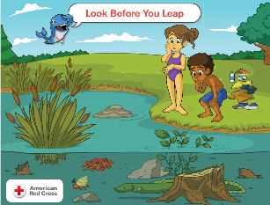
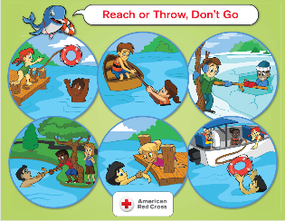
Teach Water Safety to Kids
Teach Longfellow's WHALE Tales
An acronym for Water Habits Are Learned Early, this dry-land, classroom-based course covers 11 important water safety messages, including "Swim as a Pair Near Lifeguard Chair" and "Don't Just Pack It, Wear Your Jacket."
Access materials at Redcross.org/teachwatersafety
Notes:
For children, Longfellow’s WHALE Tales teach water safety with 11 specific messages, such as “Swim as a Pair Near a Lifeguards Chair” and “Don’t Just Pack It, Wear Your Jacket.”
WHALE Tales – an acronym for Water Habits Are Learned Early – is designed for children in grades K – 6, although the “sweet spot” tends to be about the 1st through 3rd grades.
The resources include digital materials with administrative information about setting up your sessions along with a variety of certificates that you may award at the end of your session.
There are also digital posters for all 11 topics to help you lead children through the lesson and spur discussion and decision making related to dilemmas about water safety.
This is ideal for your children’s classrooms, scout troops and such.

Slide 22
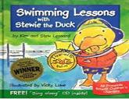
Teach Water Safety to Kids
Read stories about water safety:
Clifford Takes a Swim by Norman Bridwell
Josh the Baby Otter: A Tale Promoting Water Safety for Children by Blake Collingsworth
Stewie the Duck Learns to Swim by Kim and Stew Leonard
Swimming Lessons with Stewie the Duck by Kim and Stew Leonard
Swim Safe Little Seals: A Child's Introduction to Water Safety by Jill Macgregor
The Polar Bear Who Couldn't, Wouldn't Swim by Karen and Brian Cohn
Download the Red Cross Swim mobile app
Longfellow’s WHALE Tales video segments & quizzes included in the Kids section
Notes:
You can also help teach your children about water safety with the different children’s books that are available on the topic. These stories help bring the concepts to life. Here are just a few.
Each of these books has a different focus and story line – and you don’t know which one might resonate with a child to encourage them to be ready for their swim lessons or behave more safely around the water.
We hope that each of you will download the Red Cross Swim app. It’s loaded with water safety information including how to prevent and respond to emergencies in different aquatic environments.
There is a kids section with Longfellow’s WHALE Tales video segments with follow up quizzes to test their knowledge.
It also includes a tracker to follow your children’s progress through Red Cross swim lessons.
To download the Red Cross Swim app, go to the Apple Store or Goggle Play and search Red Cross.

Slide 23
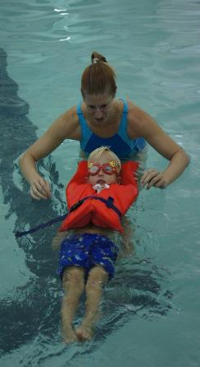
Drowning is Preventable!
Proven strategies to prevent drowning include:
Close and capable adult supervision for young children.
Reduced exposure to water hazards through use of barriers.
Supervision of recreational swimming areas.
Improved swimming and water safety skills.
Use of personal flotation devices.
Timely rescue and CPR when needed.
Source: World Health Organization Global Report on Drowning, 2014
Notes:
As we close, this recaps what we talked about today – and these are proven strategies outlined by the World Health Organization to prevent drowning. These are actually simple steps that can save lives. We urge you to apply each and every one of these steps every time you are around water so that you are water smart.

Slide 24
Thank you!
To learn more, visit:
redcross.org/watersafety
redcross.org/centennialswim

