Slide 1
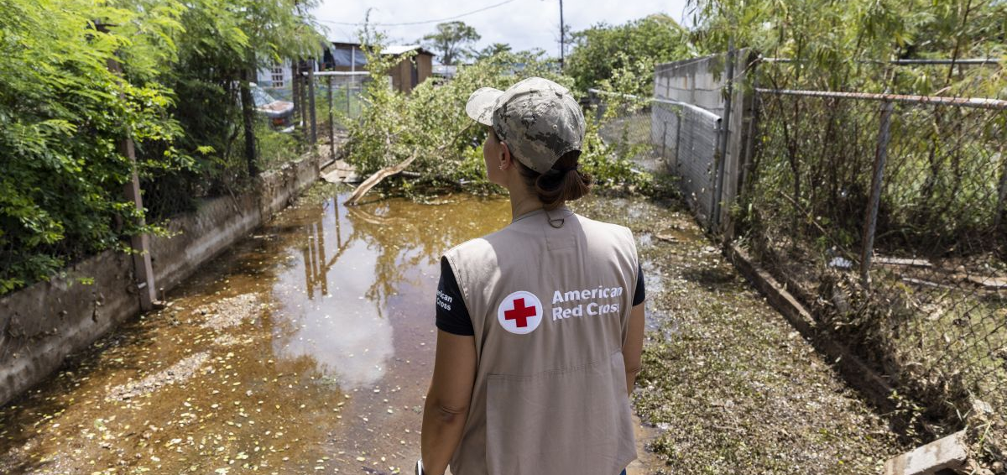
Quarterly Disaster Update
FY23 Q1 (July – September 2022)
Prepared for Disaster Responder Program Members

Slide 2
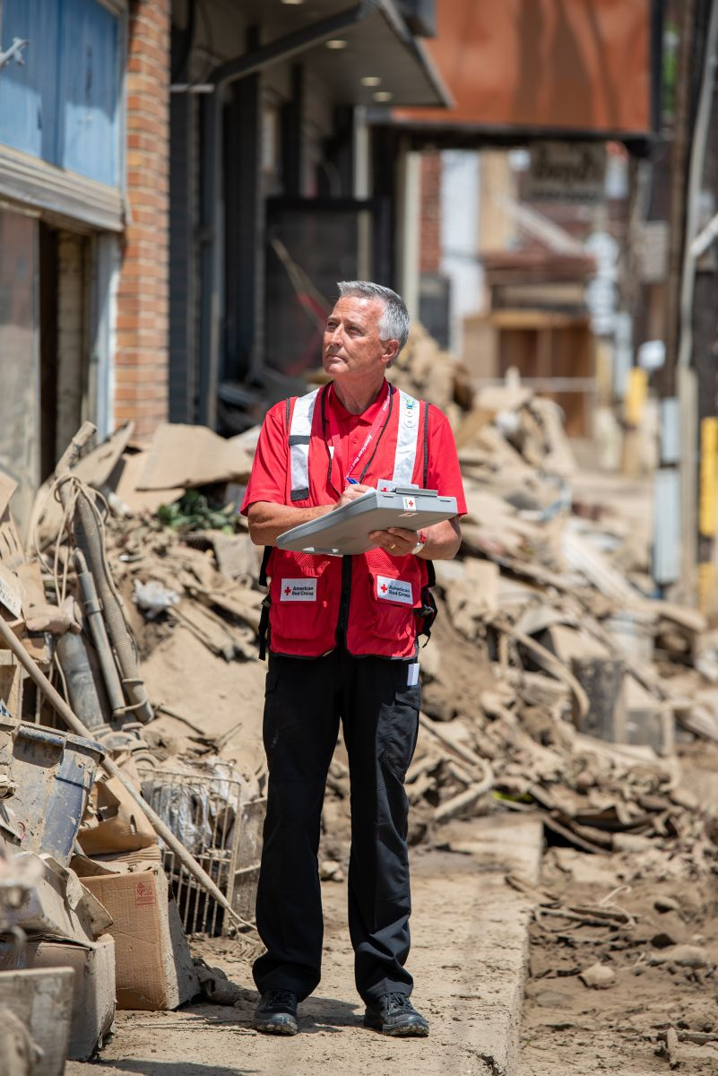
Quarterly Disaster Update
FY23 Q1 (July – September 2022)
CONTENTS
Slide 3 Domestic Response
Slide 9 Home Fire Campaign
Slide 13 International Services
Slide 18 Mission Adaptations
Slide 23 Your Partnership

Slide 3
Domestic Response

Slide 4
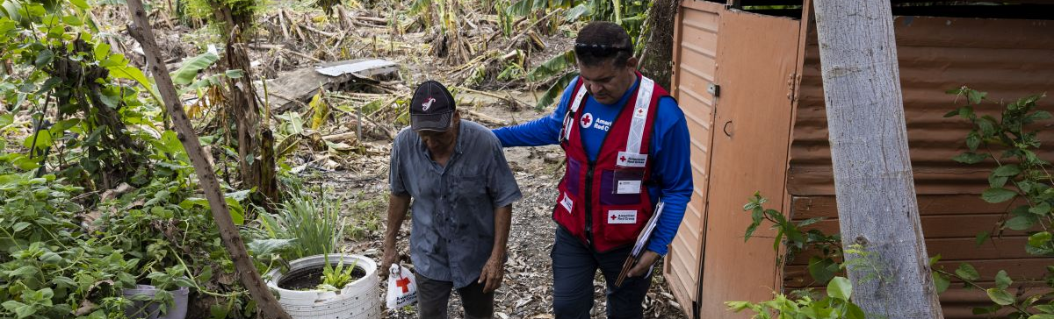
Between July and October 2022, we provided help and hope to thousands of families facing their darkest moments.
When wildfires, hurricanes and severe storms devastated communities across the country, American Red Cross teams were there. Standing with impacted individuals and families, our volunteers offered critical care and comfort in the face of tragedy, thanks to Disaster Responder Program members like you. Your generosity allowed us to spring into action when help couldn’t wait.

Slide 5
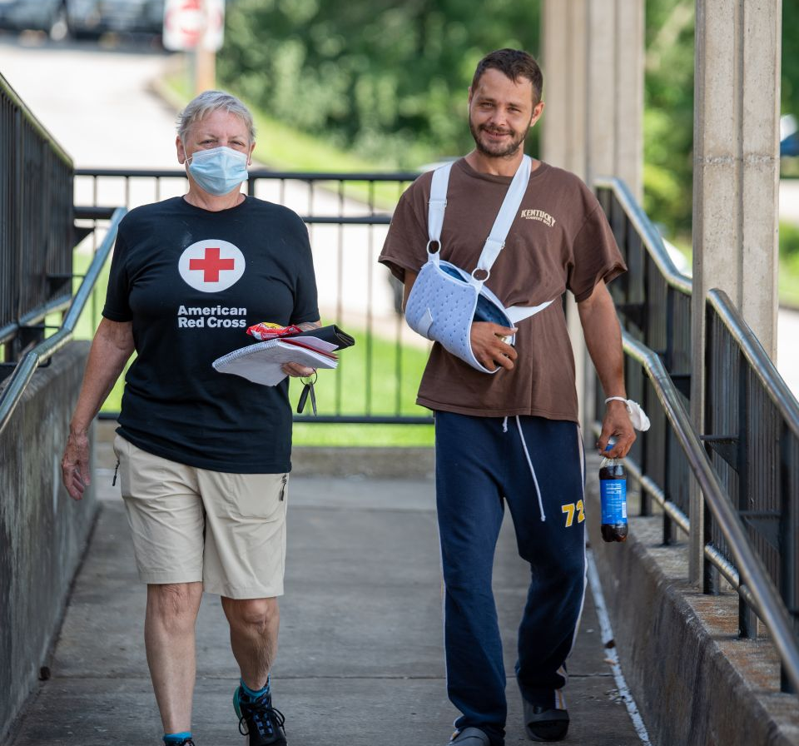
“I’m grateful for the Red Cross. They took me in and treated me like family.”
- Joshua Wagers, who found safe refuge at a Red Cross shelter in Campton, Kentucky following the devastating August floods.
Experiencing homelessness, Joshua Wagers was staying with friends in Jackson, Kentucky, when torrential storms caused catastrophic flooding. As water engulfed the house, they were saved by a passing helicopter, but Joshua was injured during the rescue. Once discharged from the hospital, he found refuge at a Red Cross shelter. There, he and other shelter residents received warm meals, care, comfort and access to necessities like personal hygiene kits and other critical relief supplies. Caseworkers also met with those who needed extra help to determine what resources could aid their recovery.

Slide 6
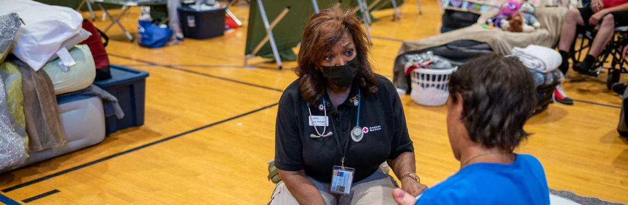
Disaster Responder donors help us stay flexible in a rapidly changing disaster environment, allowing us to deliver our lifesaving services.
In the face of relentless disasters, every second counts. The forward-thinking commitment from Disaster Responder Program members like you allows us to stay nimble and be where we’re needed most. Because of you, we’re prepared before disasters strike, bringing immediate relief to people when the unthinkable occurs.

Slide 7
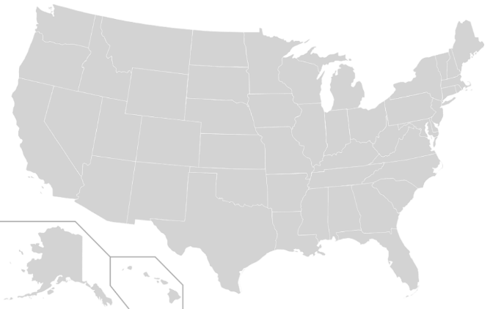
Domestic Response Quarterly Totals
Highland Park IL civil disturbance (Level 3)
Gold Country CA Wildfire (Level 4)
Gold Country CA Wildfire Companion (Level 5)
Muskogee OK Multi-Family Fire (Level 3)
NC Storms (Level 3)
Southwest VA Floods (Level 3)
TX Border Operations (Level 3)
CA Oak Fire (Level 3)
Balch Springs TX Fire (Level 3)
St. Louis MO Floods (Level 4)
Eastern KY Floods (Level 5)
TX Floods (Level 3)
ALMS Floods (Level 3)
Gold Country CA Wildfire Companion (Level 4)
Southern CA Fires and Floods (Level 3)
Central CA Fires (Level 3)
Typhoon Merbok (Level 4)
Hurricane Fiona (Level 5)
FL Hurricane Ian (Level 7)
AL Hurricane Ian (Level 3)
GA Hurricane Ian (Level 3)
NC Hurricane Ian (Level 3)
SC Hurricane Ian (Level 3)
The Red Cross responded to 81 large disasters across the country, including 23 very large events.
14
1
2
3
8
11
6
16
10
5
15
4
23
22
9
13
21
12
20
19
17
7
18
“Large” includes domestic disaster operations with costs of $10,000+ (i.e., level 2 and higher).
“Very large” includes domestic disaster operations with costs of $50,000+ (i.e., level 3 and higher).

Slide 8




Domestic Response Quarterly Totals
This quarter, over 5,800 Red Cross disaster workers provided
critical services in lockstep with our partners across the U.S.
1.3 million
meals and snacks served with partners
45,500
overnight stays in emergency lodging provided with partners
121,500
households provided relief items
6,100
households provided recovery support
FY23 Totals
121,500
6,100
1.3 million
45,500
Includes domestic disaster operations with costs of $10,000+ (i.e., level 2 and higher).

Slide 9
Home Fire Campaign

Slide 10



Home Fire Campaign Quarterly Totals
This quarter, over 5,000 dedicated Red Cross home fire workers provided critical services to help families prepare for and recover from home fires in lockstep with our partners across the U.S.
36,300
smoke alarms installed
14,100
homes made
safer
13,000
home fire
responses
50,500
individuals received financial assistance
21,300
youth reached with preparedness education
FY23 Totals
36,300
14,100
13,000
50,500
21,300
Includes domestic disaster operations with costs under $50,000 (i.e., level 1 and 2 disasters).

Slide 11
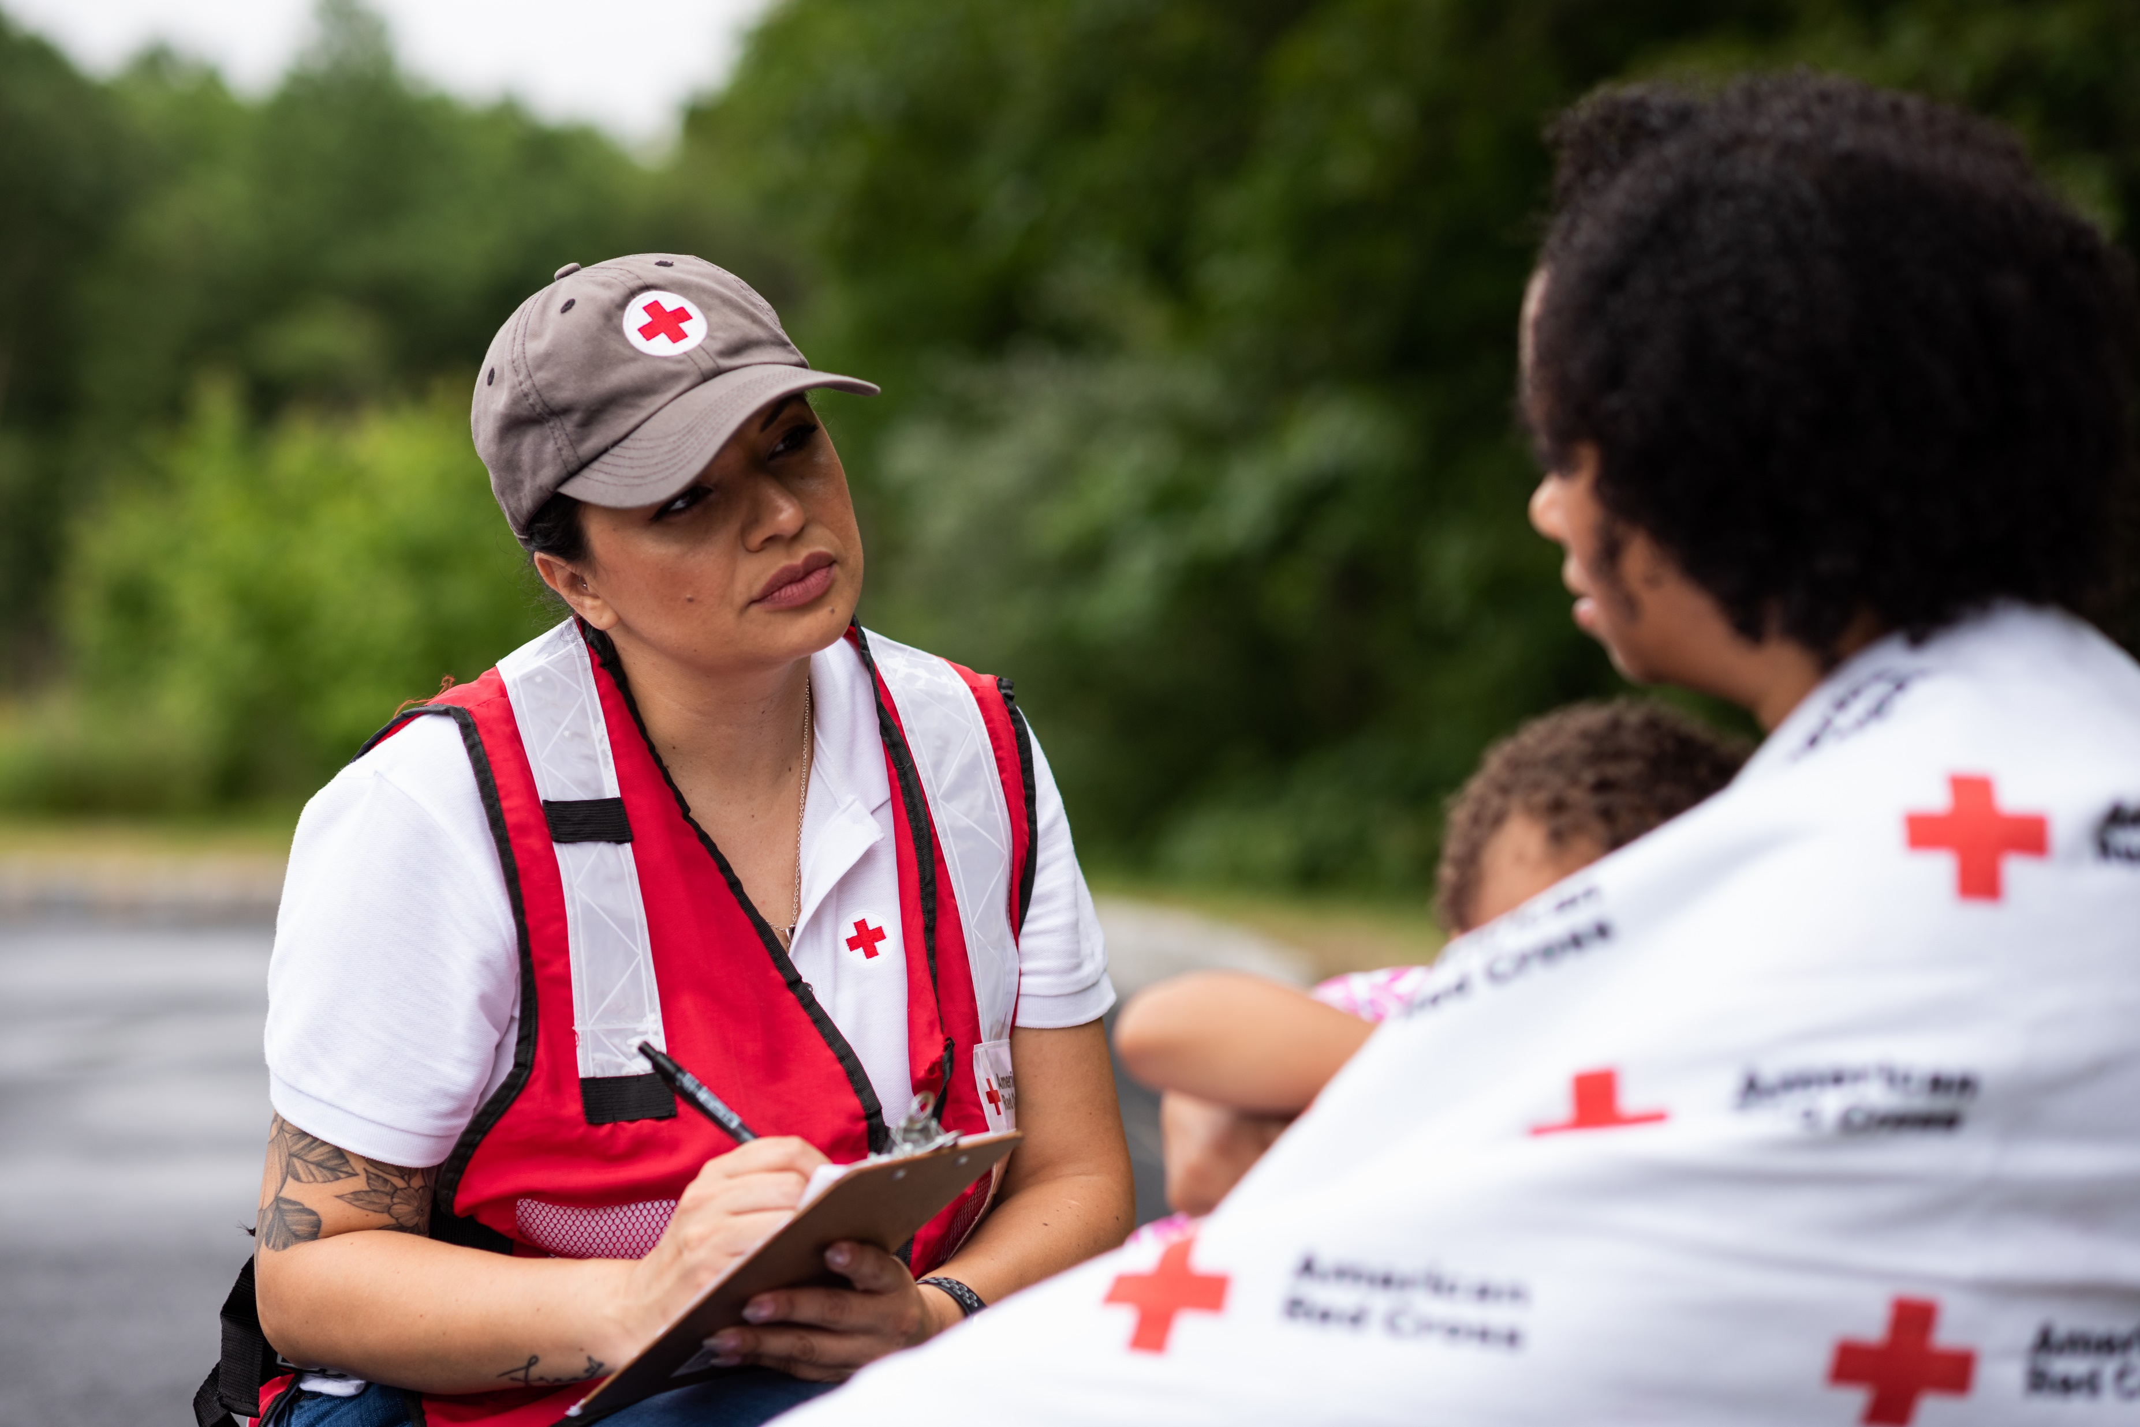
This Quarter
The need for critical Red Cross home fire relief services continues to grow.
We opened over 19,000 home fire cases in the first quarter of our 2023 fiscal year – an 11% increase compared to the same timeframe last year.
We’re also distributing more financial assistance dollars. We provided $12.5 million in the first quarter this year, up 12% from this time in FY22.
.

Slide 12
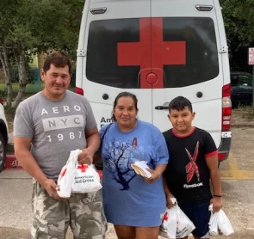
“When I … saw the Red Cross, I felt relief. It was a blessing that they were here to help us open a new door and start over.”
Rosa Quiroz
Home fire survivor
Greenpoint, Texas
When Rosa Quiroz’s family gathered for dinner on July 25, she was excited and proud. Her son had bought the family dinner. But her excitement quickly turned into fear when smoke started seeping in.
The family fled and made it out safely, but their apartment was badly damaged in the fire. In their hour of need, the Red Cross was there for Rosa and 67 other impacted families. To help the Quirozes, we provided financial assistance, which Rosa described as “a blessing.” On average, we provide $664 in financial assistance to families in need.

Slide 13
International Services

Slide 14
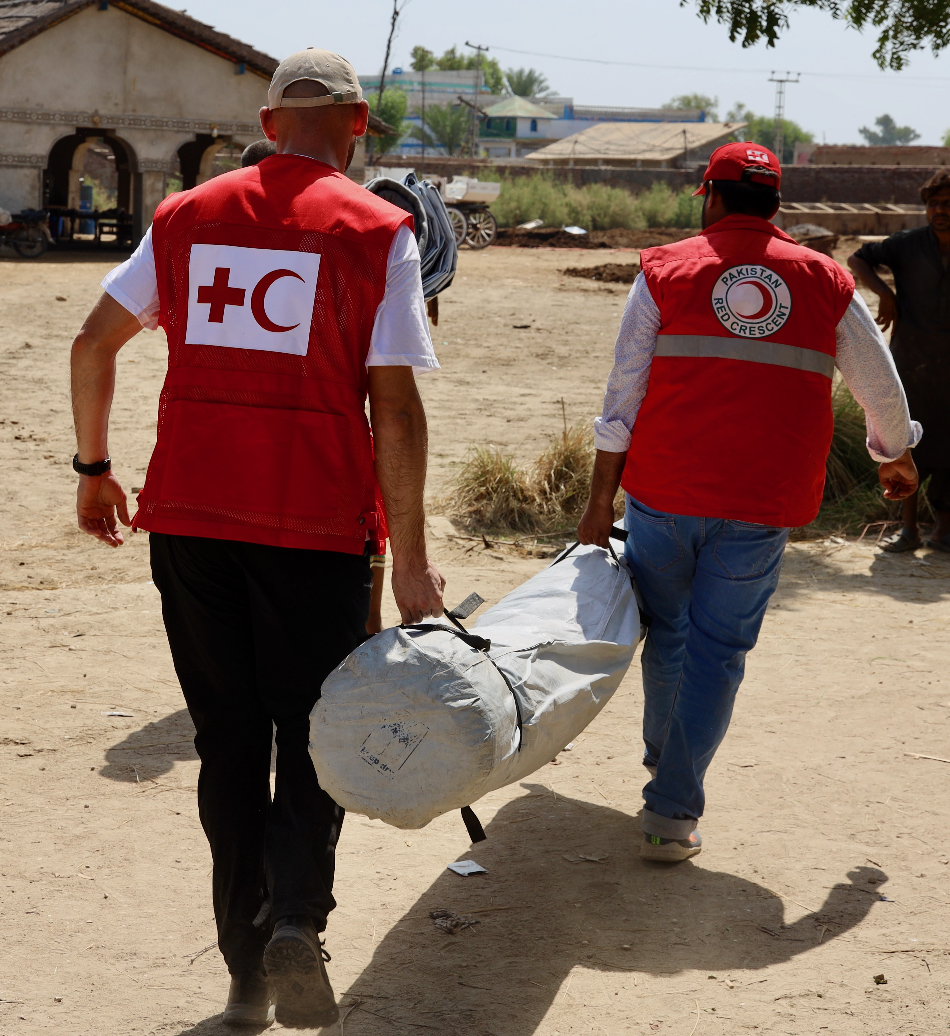
As part of the world’s largest humanitarian network, the American Red Cross plays an important role in responding to disasters around the globe.
Our teams – and our partners in the global Red Cross and Red Crescent movement – are there in response to extreme disasters, like the recent unprecedented flooding in Pakistan. Severe monsoon rains caused widespread flooding and landslides, which impacted livelihoods, homes and infrastructure. The global Red Cross has reached approximately 270,000 people in Pakistan with emergency relief. And in times like these, the American Red Cross even deploys specialists to lend expertise and a helping hand on the ground.

Slide 15

“This will give me some certainty. Everything is broken at home, and at least we can build something better here.”
Nadia, an English teacher working with young children in the Kharkiv district in Ukraine, fled for Poland when her city was attacked. She received cash assistance from Red Cross while staying in a shelter in northern Poland run by the local Red Cross branch, to buy supplies to restart her life.
August marked six months since the Ukraine Humanitarian Crisis began, and the need still remains urgent. Schools, healthcare facilities, homes and other infrastructure have been damaged or destroyed, and many people who fled their homes are unsure what to do next. The American Red Cross is providing an innovative cash assistance program to people suffering loss and hardship. Cash assistance is a dignified and efficient way to support people impacted by the conflict, allowing them to purchase items specific to their individual needs, while also supporting local economies.

Slide 16
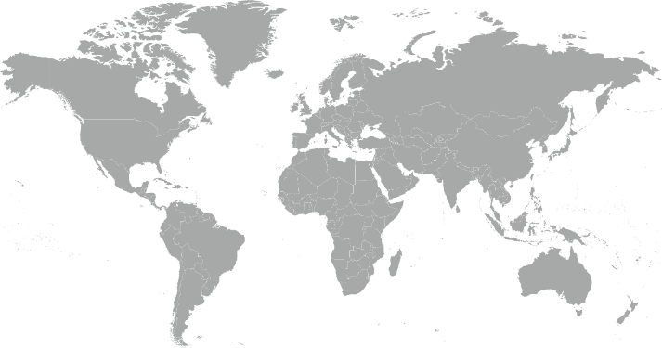
International Services Quarterly Totals
The American Red Cross began or continued responses to 10 major emergencies around the world.
Afghanistan Humanitarian Crisis
Bangladesh Flash Flood
El Salvador Floods and Landslides
Indonesia Bengkulu Province Flash Flood
Malawi Tropical Storm Ana
Mexico and Central American Migration Crisis
Nepal Floods and Landslide
Pakistan Monsoon Floods
South Africa Floods and Landslides
Ukraine and Impacted Countries Crisis
10
1
7
8
2
6
3
4
5
9

Slide 17
International Services Quarterly Totals
The American Red Cross actively supported
disaster preparedness, relief and recovery work in 11 countries.
$7.6M
donated to Red Cross and Red Crescent efforts*
3
American Red Cross specialists deployed
1,011
families
reconnected after disasters/conflicts
18
preparedness/ risk reduction projects
FY23 Totals
$7.6M
3
1,011
18
*Reflects funds donated by American Red Cross to the International Federation of Red Cross and Red Crescent Societies, the International Committee of the Red Cross, and Red Cross and Red Crescent national societies following specific disasters.

Slide 18
Mission Adaptations

Slide 19
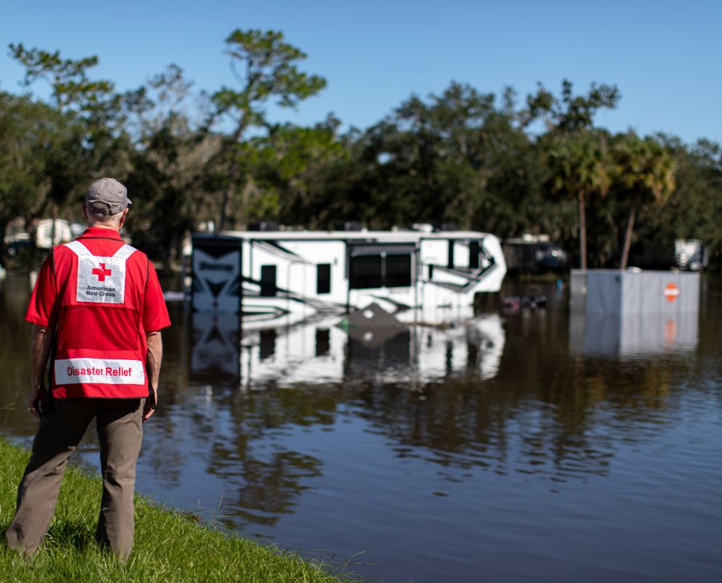
Adapting Our Mission to Meet Urgent Needs in the US…
The Red Cross is uniquely positioned to help address problems faced by people impacted by climate change. We are increasing our budget by $20M in FY23, with plans to increase at an accelerating rate over the next five years, in order to:
Launch new community-based programs
Expand our financial assistance program
Grow our
disaster network
Enhance some of
our sheltering and casework practices
While preserving critical resources in order to respond to disasters 24/7
We look forward to sharing additional information about this commitment in the year ahead!

Slide 20
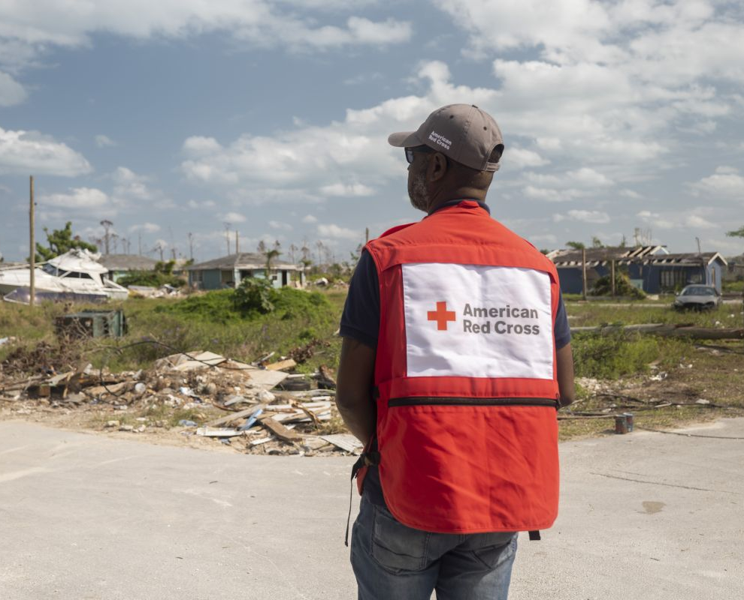
And Around the World.
For global communities facing the impacts of the climate crisis, the American Red Cross is working closely with international partners to address critical needs. We are:
Expanding the number of partner countries to which we provide support
Reducing climate disaster risks in urban areas
Institutionalizing pre-disaster “anticipatory” actions
Training and engaging youth leaders

Slide 21


Domestic Mission Highlight:
Launching Community Adaptation Programs
What is our goal?
To build community resilience and partner capacity to weather future disaster events.
What are we doing?
Launching a community-based adaptation initiative, initially piloted in eight communities at high risk of disaster and with high social vulnerability.
Recruiting, hiring and training teams of experienced local leaders and empowering them to build partnerships with regional organizations that focus on health, housing and hunger.
What have we accomplished so far?
We’ve hired 20 of our 24 Mission Adaptation field team member positions.
We’ve initiated a 90-Day Community/Partner Assessment process in all 8 communities and plan to officially launch the Program in over the next 2 months.
Pilot programs in eight high-risk communities:
1
2
7
5
3
6
8
4
CALIFORNIA
Lake County, CA
Butte County, CA
ARKANSAS
Mississippi County, AR
LOUISIANA
Terrebonne Parish, LA
TENNESSEE
Madison County, TN
MISSISSIPPI
Yazoo County, MS
KENTUCKY
7. Warren County, KY
ALABAMA
8. Montgomery County, AL

Slide 22
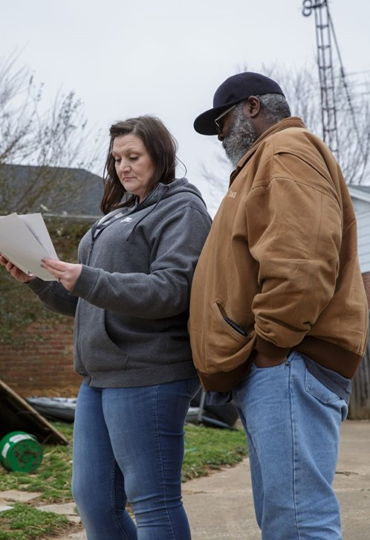
Domestic Mission Highlight:
Expanding Financial Assistance
What is our goal?
Help with critical needs like rent, home repairs, childcare costs, transportation to return to work and more.
New pre-approvals and increased on the ground support for 20+ more events per year, ~ $5M more distributed directly to our clients who need it most.
What have we accomplished so far?
We’ve launched eight bridge assistance programs for Level 4 DROs in 2022 to date (Jan. 1 – Sept. 30, 2022).
What are we doing?
We are now providing long-term recovery financial assistance following Level 4 disasters. ¹
The Ennis Family received support to rebuild their home following a tornado.
¹ Level 4 disasters cost between $250,000 - $2.5M.

Slide 23
Your Partnership

Slide 24
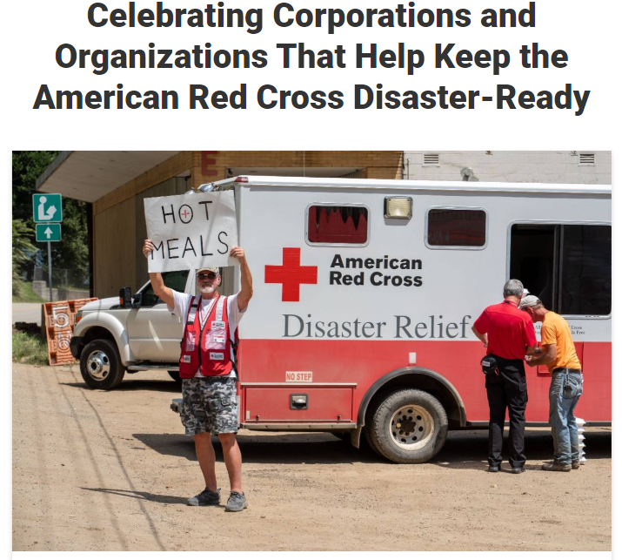
Benefits and Resources
We were pleased to provide valuable recognition and engagement this quarter.
Acknowledgement in annual member recognition press release issued on PR Newswire and redcross.org Sept. 13:
  Reached total potential audience of nearly 165 million with notable placements, including yahoo Finance, AP, MarketWatch, Markets Insider and Morningstar
  Publicized on Red Cross LinkedIn to 375,000+ followers
Invitation to exclusive Disaster Leadership Roundtable call sharing our response to Hurricane Ian on Sept. 29
Template communications materials provided, including social posts and content that aligned with timely messaging around Hurricane Ian, Western Wildfires, summer safety, the need for disaster volunteers, National Preparedness Month and Fire Prevention Week

Slide 25
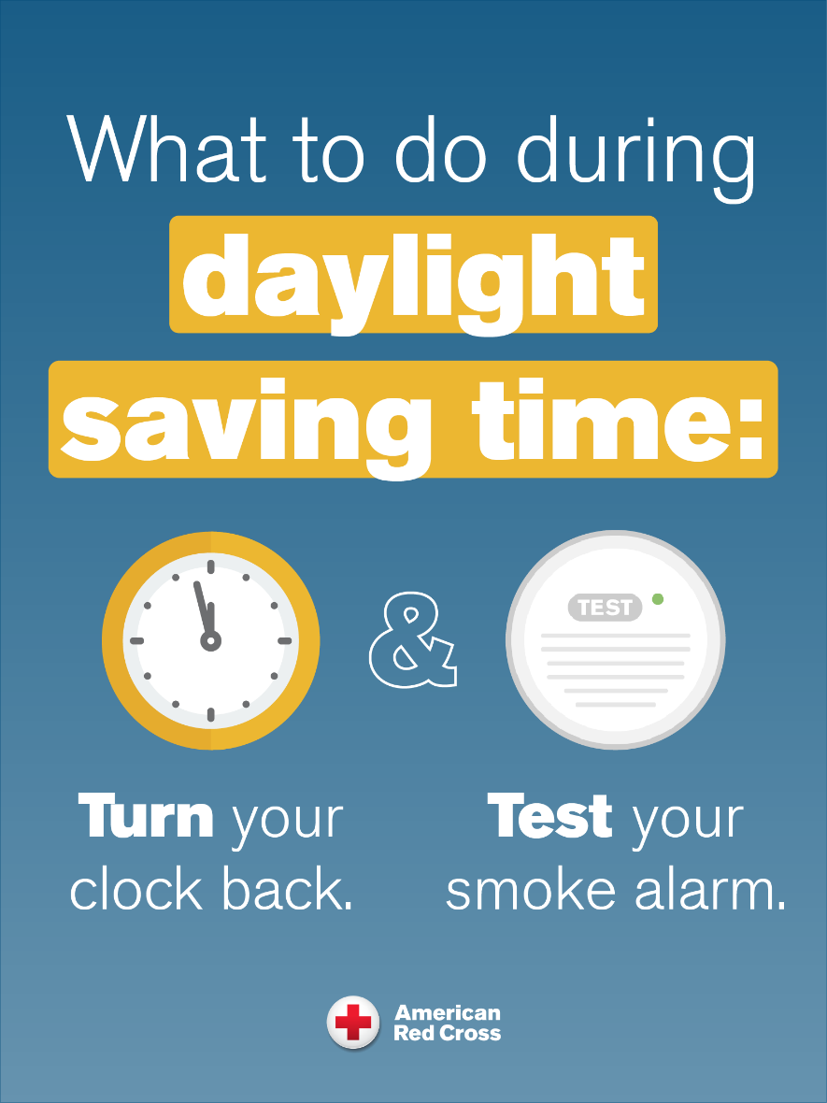
Join Us!
At the beginning and end of daylight-saving time, we encourage people to TEST their smoke alarms when they TURN their clocks.
Would you consider sharing home fire safety messages with your employees, customers and other key groups before we “fall back” on November 6?
Download
Turn and Test Home Fire Safety Communications Resources
prepared just for you!

Slide 26
